Slide 1
Welcome to our presentation
Presented by
Md Shahnewaz Abid Id:16172103016
Romana Hossain Id:12133103035
Kawsher Mahbub Id:16172103282
Sajjad Hossein Id:16172103294
Shuvrodeb Sarkar Id:16172103344
Tariful Islam Tuhin Id:16172103358

Slide 2


Problem & Prospects of IT Industry in Bangladesh

Slide 3
INTRODUCTION
The IT industry is a relatively new sector in the country's economy. Though it is yet to make tangible contributions in the national economy, it is an important growth industry.IT sector is now the 3rd big sector from where we get foriegn currency .But After 2 or 3 years it will be the 1st sector .Every year so many educated people ,students and also the government trying to improve the sector .No other sector rising as much as the IT sector in Bangladesh .But the sector’s rising still now facing many problems .The IT sector related people trying to solve the problem .But After all we will be hopeful about the IT industry in Bangladesh.

Slide 4
Problems of IT Industry
Though IT industry is the most rising sector in Bangladesh ,but there is so
much problems. Such like that,
Village people don’t know about IT much.
High price of bandwidth.
Not growing good hardware companies.
High price of IT products.
Electricity problem.
Lack of practical knowledge about technology.

Slide 5
Problems of IT Industry
Need land to build a factory.
Crisis of hardware to use full bandwidth.
Political various reason.

Slide 6
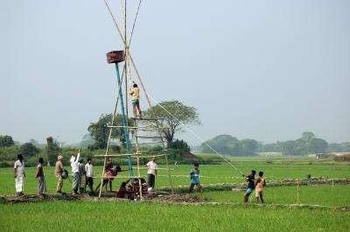
Village people don’t know about IT much
60% people of our country
population lives in village. But it is a matter of sorrow that they don’t know well about technology. So their children don’t know about technology good.If we can successful to use to them about technology,it will be a great achievement.

Slide 7
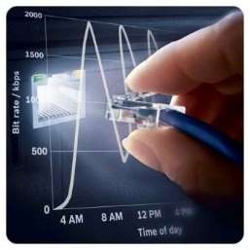
High price of bandwidth.
High price of bandwidth is another
problem of our IT industry. If we think about the world or at least about the south asia ,we will se that the bandwidth price is high than any other countries. We know that bandwidth like a fuel of our technology sector.

Slide 8
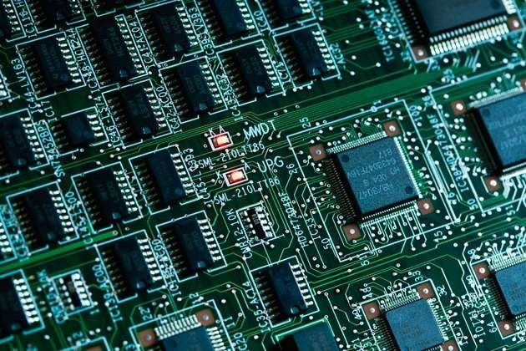
Not growing good hardware companies.
It is a matter of sorrow that we don’t
have any good hardware companies. Our hardware sector don’t grow as much as software part. It is a big problem for our country specially IT industry.

Slide 9

High price of IT products.
Though we achieve many success in
IT sector but still now IT products such like PC ,Laptop ,Mobile ,Printer’s price is high. We need to keep this products price at a reasonable level.

Slide 10

Electricity problem.
Electricity problem is one of the
most problem in our country.so
simply it is a problem in IT sector. For the crisis of electricity ,many IT industry can not create their product. In village the electricity problem is more more bigger than the city
area. World Development bank did a
research and they said that the growth of our IT industry 6% slower because the crisis of electricity.

Slide 11
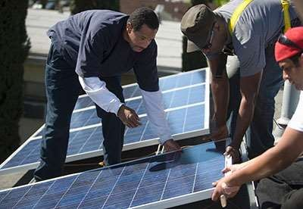
Lack of practical knowledge about technology.
In the IT sector practical knowledge is must.In this sector practical knowledge is more valueable than the theoretical knowledge. But in Bangladesh there is a problem of the practical knowledge. Lack of practical knowledge about technology trying to stop our success.

Slide 12
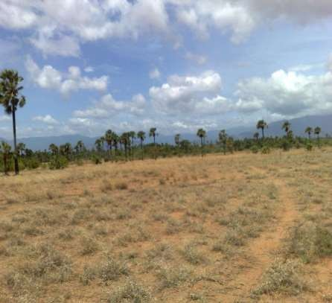
Need land to build a factory.
Bangladesh is a small country. So we
do not get many land to build a factory. Because the crisis of land we don’t start big factories. This is a
problem. Few month’s ago Indian TATA company came Bangladesh and they want land so that they
build a factory. But we don’t able to give them.

Slide 13

Crisis of hardware to use full bandwidth.
Every year we buy bandwidth what is
so much costly but unfortunately we do not use the full bandwidth. It will be unbleaveable for many people but it is true that we use just 40% of bandwidth. Other 60% is unused because we have no technology to use the 60%.

Slide 14
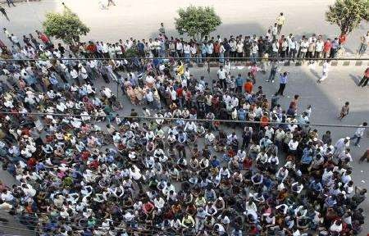
Political various reason.
Political various reason is also a
cause to develop our IT industry .Our country’s political situation does not remain stable all the time. Due to this reason our IT industry will not develop.

Slide 15

Prospects of IT Industry In Bangladesh
Besides this problems our IT industry growing day by day. Our people especially village people knowing
about technology. It is a big achievement. Our government take some important project to build a technological nation. One
of the most popular project is
“Digital Bangladesh”. Government take plan to build a digital Bangladesh.
The another plan is “vision 2021”.

Slide 16

Various Report About Our IT Sector
“Bangladesh’s IT sector gradually come a strong position”-World
Bank.
“Bangladesh become a good technological country day by day”- Indian telecommunication Board President.
“Bangladesh is the most quickly developing country in IT sector”-The Daily Star.

Slide 17
Our Software Export Sector
6
5
4
3
2
1
0
₂₀₁₁ Series 1
Series 3 ₂₀₁₃
2010
201 4

Slide 18

In the Frelanceing Sector
“It is really good news for us that Bangladeshi freelancer get the third place among all the world. ”-Dhaka Economic News.
”The day is not so far, which day Bangladeshi freelancer will reach the first place”-Odesk manager.
Past year bangladeshi freelancer earned 2 million US$. Doing freelanceing many people being self dependable and earn money.
Many freelancer who live in village, can easily doing his job. It is a plus point for us.

Slide 19
IT Industry in Our Country Economy
Garments Sector
Workers
IT Industry
Other

Slide 20
Technology in School,College,other places
Today technology reaches school, college and other places. In the syllabus
technology added and school ,college read this subject seriously. So students starting learn well about technology. Student take higher degree about technology and join in the IT industry. school ,college, university make wifi in their place, build computer in their place. In the village school,college are at the same stage. There also free net connection. Though there is no as much facilities as the city area. But village situation changing continuously.

Slide 21
Our Achievement
We have so many achievement in our IT industry.We get many
foreign currency via this IT industry. Our 10+ students get job in Google. Past year 3+ students got job in google .Our countryman Jawed Karim is the Co-founder of Youtube. There are also many public who go to abroad for job. They are all educated and they job in the IT sector.

Slide 22
CONCLUSION
At last we can say that Bangladesh IT industry ging better day by
day. Though it has many problem but it will be top in a short
time. Bangladesh government trying hard to solve these problems and add various facilities. The day is not far, which day Bangladesh IT industry will top among all the world’s IT sector.

